Slide 1
.NET Development Repository Pattern
DATA ACCESS DESIGN PATTERNS

Slide 2
The concept
Almost all software interacts (CRUD) with a database system.
.Net developers use ORM tools like Entity Framework or Dapper to access these databases smoothly and efficiently.
BUT the concern is how to use these ORM tools to write code that is
reusable
maintainable
readable
and above all testable
This is were design patterns focus on. The repository and unit of work pattern try to solve common problems with database access and business logic transactions.

Slide 3
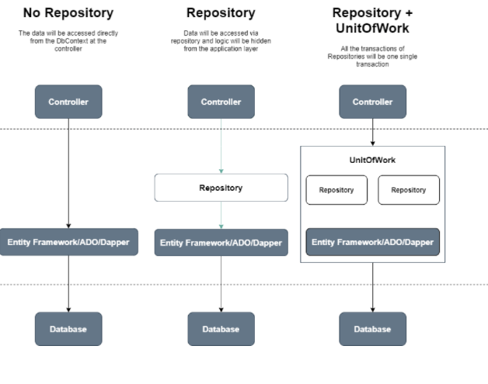
3 approaches for data access
In the course ASP.NET MVC you learned how to use Entity Framework to manage all database transactions.
The DbContext was instantiated directly in the controller to gain access to the EF DbSets.
In this chapter we create an extra layer called a Repository. Next chapter the Unit of Work pattern is explained.

Slide 4
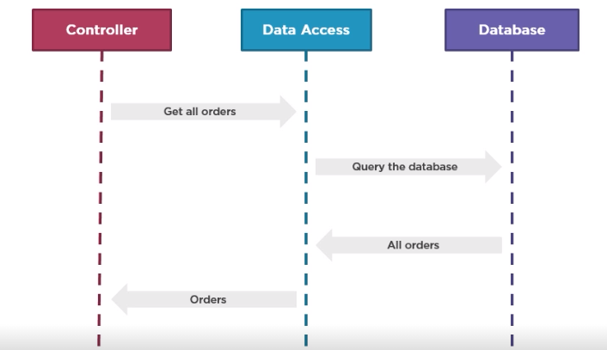
No repository
The controller (the application layer) is tightly coupled with the DAL (Data Access Layer) Testing the controller is more difficult while tests differ depending on the ORM used.
Hard to extend the model entities.
Course ASP.NET MVC
Get all movies
Query the database
All movie records
Movie entities

Slide 5
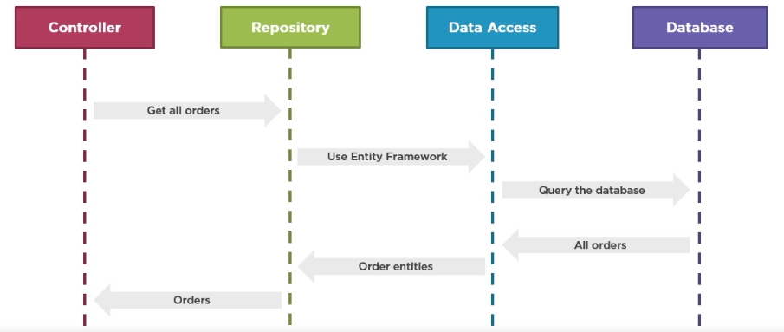
Applying the repository pattern
The controller is decoupled from the DAL.
A repository class moves in between and decides on the ORM to use. Model entities can be changed before they reach the controller. Lazy loading
Testing the controllers becomes more easily.
Get all movies
Movie entities
All movie records
Movie objects

Slide 6
What is a repository?
A repository encapsulates data access.
Repositories are just classes that implement data access logic and provide a data access service to the application layer.
The application layer as a consumer of the repository doesn’t need to know whether or not ADO.NET, EF or other ORMs like Dapper, … are used neither needs to care about the underlying data structure.

Slide 7
What is Unit of Work?
A Unit of Work acts as a business transaction.
The Unit of Work will merge all the transactions (Create/Update/Delete) of Repositories into a single transaction.
All changes will be committed only once.
They will be rolled back if any transaction fails to ensure data integrity.
People often consider the Unit of Work a lazy evaluation transaction because it will not block any data table until it commits the changes

Slide 8
Repositories without Unit Of Work
Each repository will generate and maintain its own DBContext class.
Each DBContext has its own in-memory list of changes of the entities that are being added/updated/deleted in a single transaction.
This might lead to inconsistencies when the SaveChanges request from one DbContext succeeds while the other one fails.
Movie Controller
Movie Repository with its own DbContext
Rating Controller
Rating Repository with its own DbContext
Notes:
Non-generic versus generic repository. Here non-generic → each entity has its own repository
Generic → all entities use the same repository

Slide 9
Repositories with Unit of Work
To avoid inconsistent transactions, we will add another layer between the controller and the repositories.
This layer will act as a centralized store for all the repositories to receive the instance of the DbContext.
This will ensure that, for a unit of transaction that spans across multiple repositories, it should either complete for all entities or should fail and rollback entirely.
UnitOfWork class provides DbContext instance
Movie Repository receives DbContext
Movie Controller
Rating Controller
Rating Repository receives DbContext
Notes:
In the above representation, during a single operation, that involves Movie and Rating entities, both of them use the same DbContext instance. This will ensure that even if one of them breaks, the other one is also not saved, thus maintaining the database consistency. So when SaveChanges is executed, it will be done for both of the repositories.

Slide 10
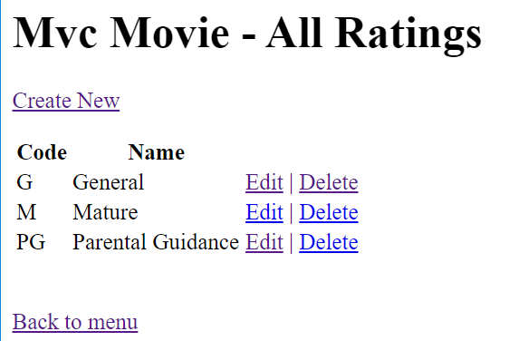
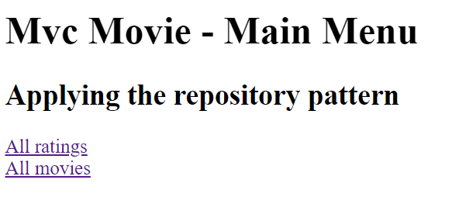
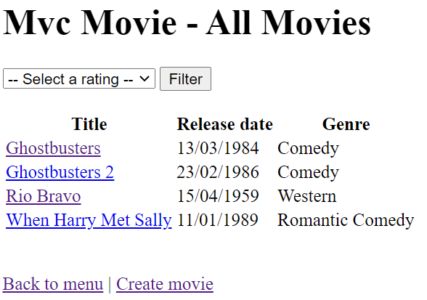
Demo
Open the solution “MVCMovieDemo”
Run the application.

Slide 11
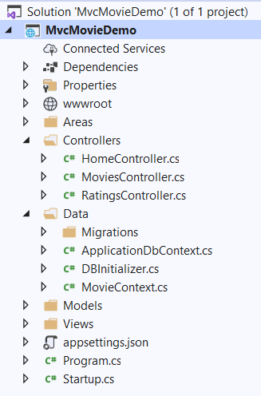
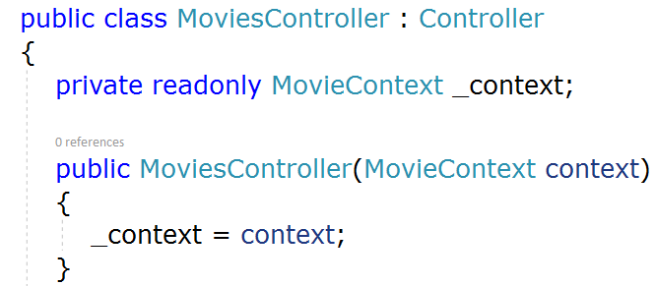
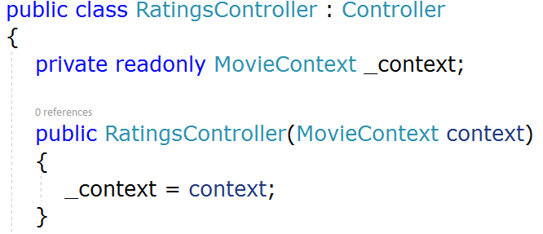
Demo
The project contains no repositories.
In the controllers the reference to EF is defined.
The controllers address the MovieContext directly.

Slide 12
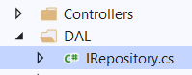
Create IRepository interface
Since each repository should contain at least the basic CRUD and query operations, it’s a good idea to define those methods at interface level. This way, you get consistency in the method definitions throughout your application.
Make a new folder ‘DAL’
Add new item | Interface ‘IRepository’

Slide 13
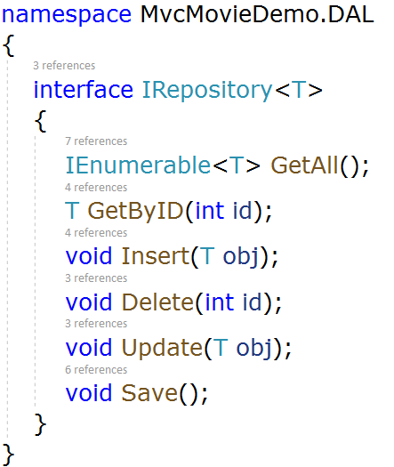
Create IRepository interface
Each repository must contain the following methods:
IEnumerable<T> GetAll()
T GetByID(int id)
void Insert(T obj)
void Delete(int id)
void Update(T obj)
void Save()
where T stands for the model entity
Notes:
interface IRepository<T> {
IEnumerable<T> GetAll();
T GetByID(int id);
void Insert(T obj);
void Delete(int id);
void Update(T obj);
void Save();
}

Slide 14
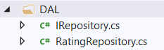
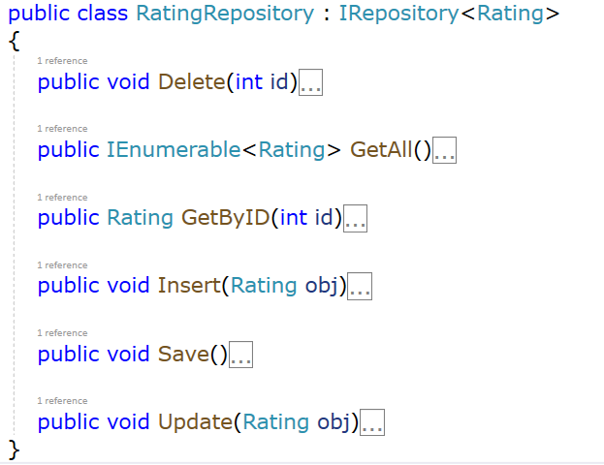
Create RatingRepository class in DAL
Add new item | Class ‘RatingRepository’
Implement the IRepository interface for a Rating entity

Slide 15
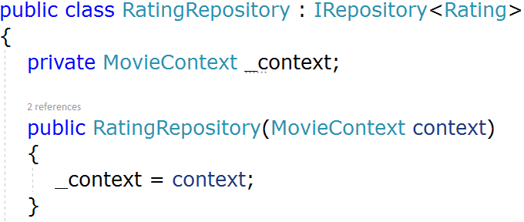
RatingRepository class
First step is to make sure the Repository can access the database context (MovieContext). This DbContext is defined in a class variable (_context), and the constructor expects the calling object to pass in an instance of the context.
Notes:
private MovieContext _context;
public RatingRepository(MovieContext context)
{
_context = context;
}

Slide 16
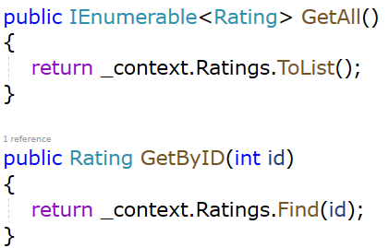
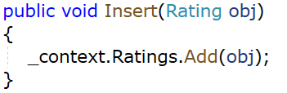
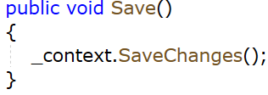
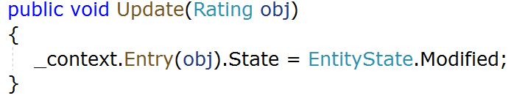
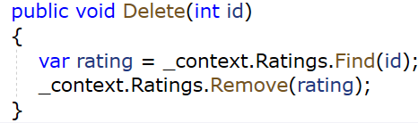
RatingRepository class
The repository’s CRUD methods make calls to the database context in the same way that you saw earlier in the controller.
Notes:
public void Delete(int id)
{
var rating = _context.Ratings.Find(id);
_context.Ratings.Remove(rating);
}
public IEnumerable<Rating> GetAll()
{
return _context.Ratings.ToList();
}
public Rating GetByID(int id)
{
return _context.Ratings.Find(id);
}
public void Insert(Rating obj)
{
_context.Ratings.Add(obj);
}
public void Save()
{
_context.SaveChanges();
}
public void Update(Rating obj)
{
_context.Entry(obj).State = EntityState.Modified;
}

Slide 17
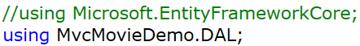
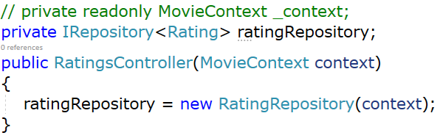
Change the RatingController to use the repository
Since only the RatingRepository interacts with the database via EF, you must delete the EF-reference. Instead you add the DAL.
Furthermore, the controller now declares a class variable for an object that implements the IRepository<Rating> interface instead of the MovieContext class. In the constructor the MovieContext is passed to the repository object.
Notes:
TO DO: RatingController vrijgeven via Resources

Slide 18
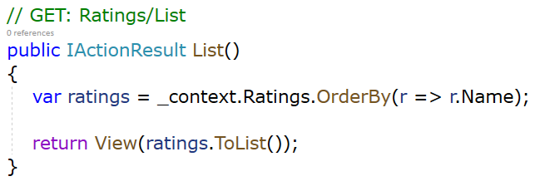
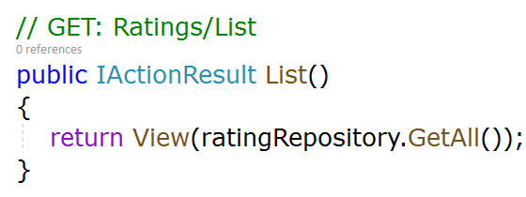
Change the RatingController to use the repository
In the CRUD methods, the repository is now called instead of the context:
FROM
TO

Slide 19
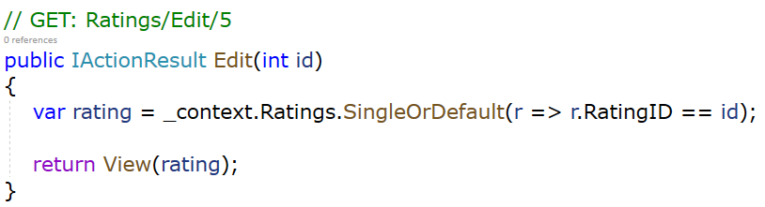
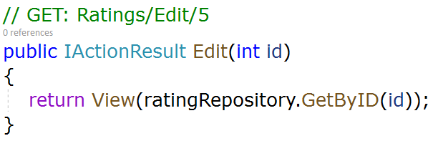
Change the RatingController to use the repository
In the CRUD methods, the repository is now called instead of the context:
FROM
TO

Slide 20
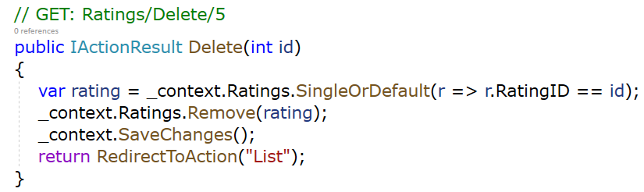
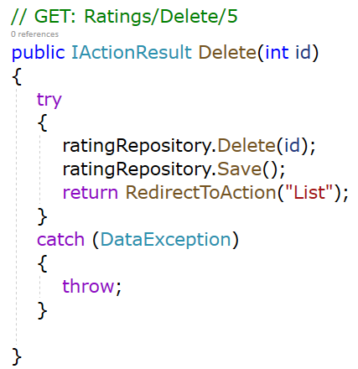
Change the RatingController to use the repository
FROM
TO
Notes:
Above, we added a custom error message using the ModelState.AddModelError() method. The ValidationSummary() method will automatically display all the error messages added into the ModelState on a web page as an unordered list element. It can also be used to display custom error messages. E.g. in View
@model Rating @Html.ValidationSummary(false, "", new { @class = "text-danger" })

Slide 21
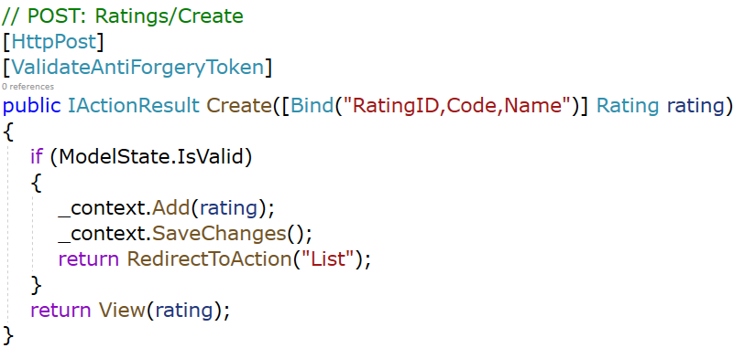
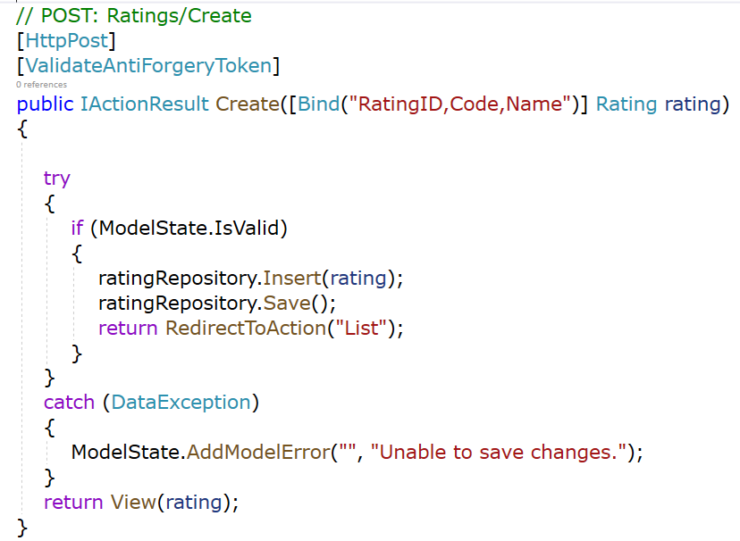
Change the RatingController to use the repository
FROM
TO
Notes:
Above, we added a custom error message using the ModelState.AddModelError() method. The ValidationSummary() method will automatically display all the error messages added into the ModelState on a web page as an unordered list element. It can also be used to display custom error messages. E.g. in View
@model Rating @Html.ValidationSummary(false, "", new { @class = "text-danger" })

Slide 22
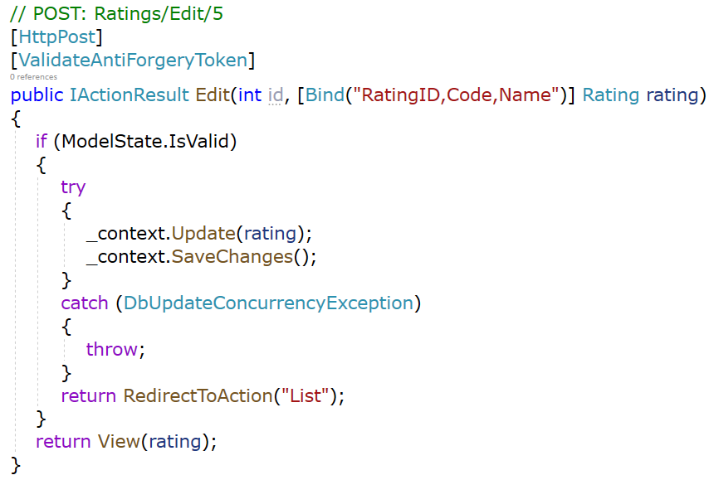
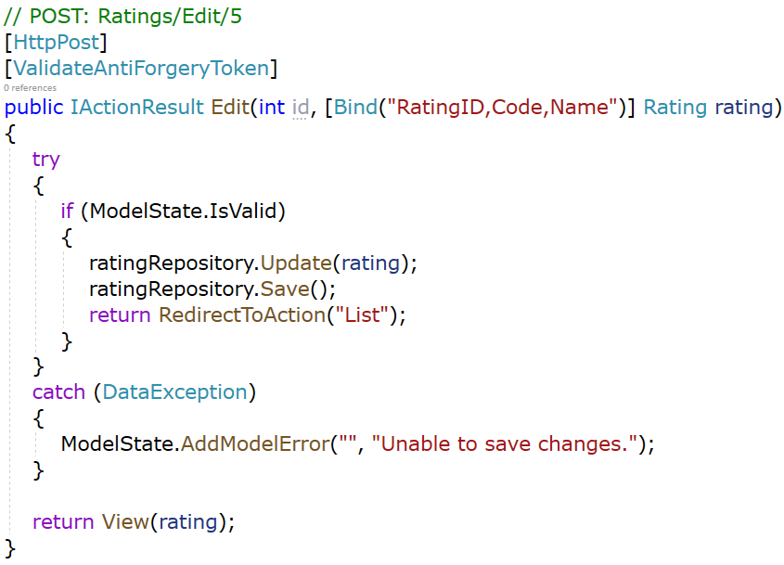
Change the RatingController to use the repository
FROM
TO
Notes:
DbUpdataConcurrencyException is EF, so cannot be kept in the repository pattern way of working.
What you can do is write the try catch around the Save() in the repository. DataException represents the exception that is thrown when errors are generated using ADO.NET components. Data Exception is defined in System.Data.

Slide 23
Test AllRatings
All actions should work identically. The main difference is now that the controller calls the Repository for all data transactions.

Slide 24
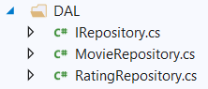
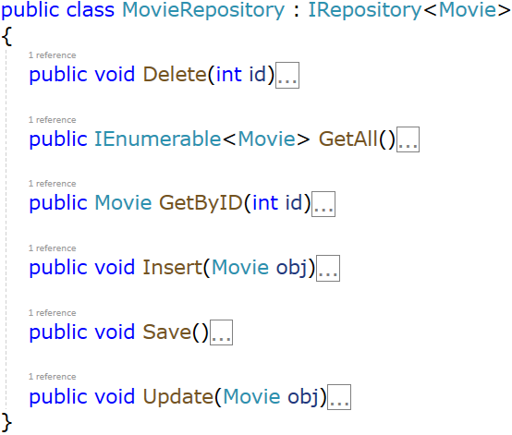
Create MovieRepository class in DAL
Add new item | Class ‘MovieRepository’
Implement the IRepository interface for a Movie entity

Slide 25
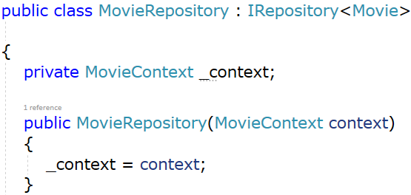
MovieRepository class
First step is to make sure the Repository can access the database context (MovieContext). This DbContext is defined in a class variable (_context), and the constructor expects the calling object to pass in an instance of the context.
Notes:
private MovieContext _context;
public MovieRepository(MovieContext context)
{
_context = context;
}

Slide 26
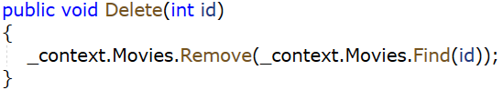
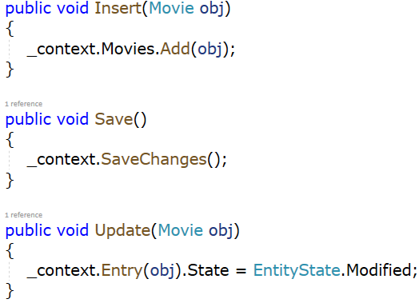
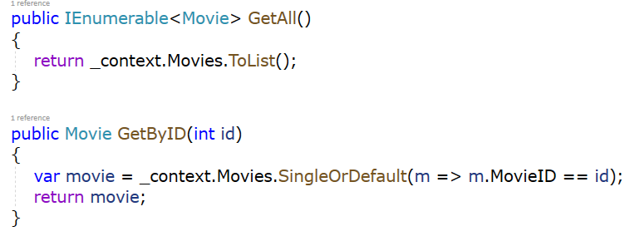
MovieRepository class
Next step is to write the necessary CRUD transactions.

Slide 27
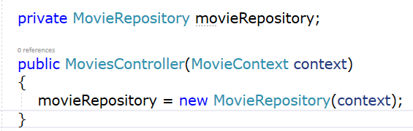
Change the MovieController to use the repository
Since only the MovieRepository interacts with the database via EF, you must delete the EF-reference. Instead, you add the DAL.
Furthermore, the controller now declares a class variable for an object that implements the IRepository<Movie> interface instead of the MovieContext class. In the constructor the MovieContext is passed to the repository object.

Slide 28
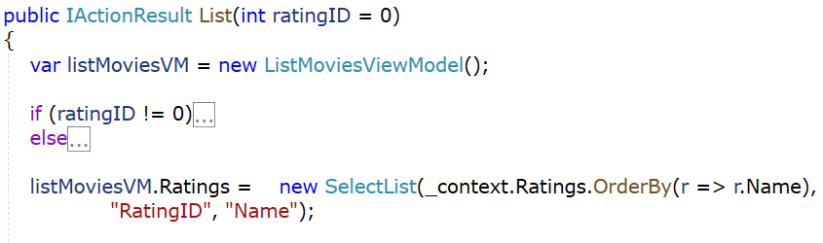
Change the MovieController to use the repository
Is only instantiating the MovieRepository enough?
No
In the controller the RatingsRepository is needed!

Slide 29
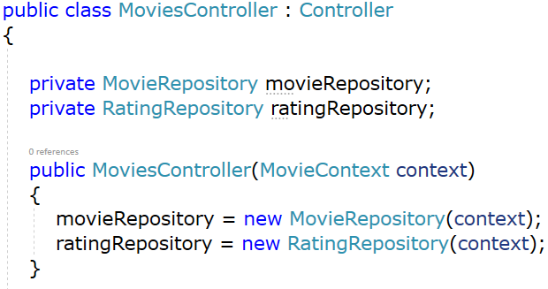
Change the MovieController to use the repository
So the controller now declares 2 class variables. One for an object that implements the IRepository<Movie> interface and another one that implements the IRepository<Rating> interface. In the constructor the MovieContext is passed to each repository object.

Slide 30
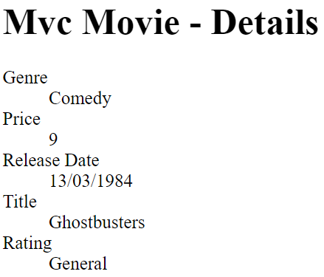
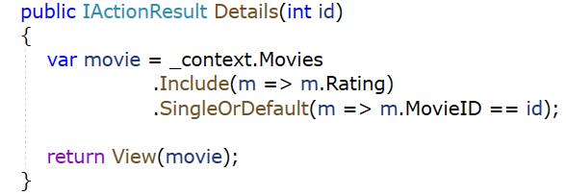
Change the MovieController to use the repository
Next step is to call in the CRUD methods the repositories instead of the database context.
Notice that on the detailspage of a movie the entire rating name appears due to the EF Eager Loading principle.

Slide 31
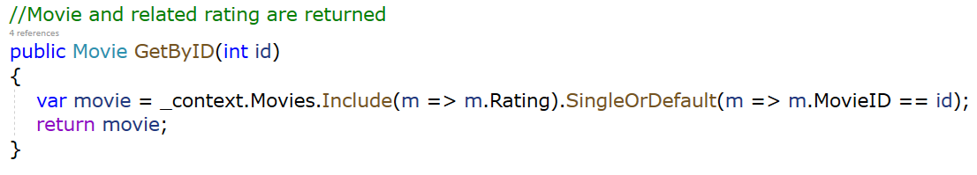
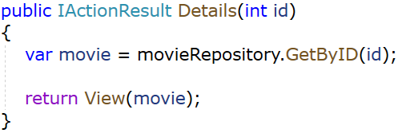
Change the MovieController to use the repository
Now this EF Eager Loading must be accomplished in the repository.
In the MovieRepository
In the MovieController:

Slide 32
Test AllMovies
All functions should work. The main difference is now that the MoviesController calls both the Repositories for all the data transactions.

Slide 33
Concept of a generic repository
Instead of creating individual repositories for each entity class, in some cases developers make use of a so-called generic repository.
A generic repository is a generic class, with basic CRUD methods in it (and of course other methods can be added as needed). This class and its member functions can be used for any entity of the database.
This means, if we have entities Movies and Ratings, this single generic repository class can be used for both of them.

Slide 34
Create a generic repository
First make a copy of your ASP.NET MVC demo application so far.
Now open this copy and in the DAL folder create a new class ‘GenericRepository.cs’
Implement the IRepository interface for a <T> entity
As a rule, the more types you can parameterize, the more flexible and reusable your code becomes. However, too much generalization can create code that is difficult for other developers to read or understand. Here the parameter passed is by constraint an Entity Class which is passed by reference.

Slide 35
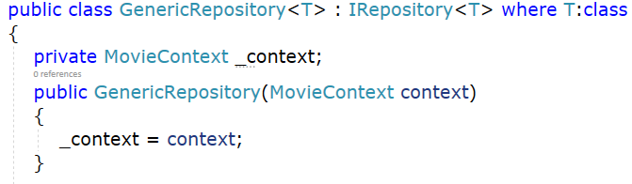
Create a generic repository
First step is to make sure the Repository can access the database context (MovieContext). This DbContext is defined in a class variable (_context), and the constructor expects the calling object to pass in an instance of the context.

Slide 36
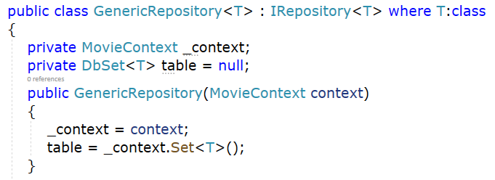
Create a generic repository
In every CRUD method the DbSet of the T entity is needed. This DbSet<T> is defined in a class variable “table” that gets initialized in the constructor.

Slide 37
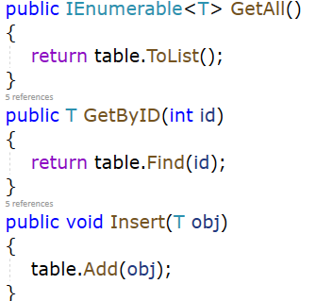
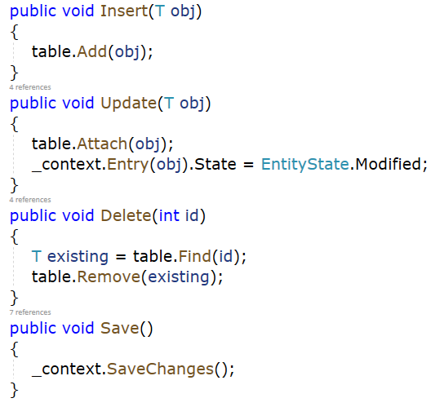
Create a generic repository

Slide 38
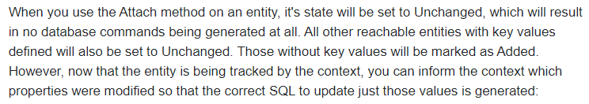
Create a generic repository

Slide 39
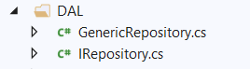

Let the RatingController use the generic repository
Delete the RatingRepository from the DAL.
Change the RatingController constructor to make sure the new GenericRepository<Rating> is used.

Slide 40


Let the MovieController use the generic repository
Delete the MovieRepository from the DAL
Change the MoviesController constructor to make sure the new GenericRepository<Rating> and GenericRepository<Movie> are used.

Slide 41

Test AllRatings & AllMovies
All actions should work identically. The main difference is now that the controller calls the GenericRepository for all data transactions.

Slide 42
Test AllRatings & AllMovies
There is still an issue because in the generic repository the eager loading (.Include) is not available.
Rating Name is not loaded!

Slide 43

Extend the generic repository
Best practice is to add this extra method to the generic repository. Goal is provide the possibility to pass LINQ expressions (Where – OrderBy – Include) as parameters to the repository GET method

Slide 44

Extend the generic repository
The Get-method is called to eager load the Rating properties when getting the MovieDetails.

Slide 45

Test AllMovies
After extending the Generic Repository the Rating entities values are eager loaded.
Rating Name is loaded!

Slide 46

Unit testing
Goal: Test the ‘List’ method in the ‘MoviesController’:

Slide 47

Steps
Don’t inject the DbContext in the controller’s constructor, but inject the repositories:

Slide 48

Steps
Register the MovieContext (which is injected in the GenericRepository) and the GenericRepository in the DI container
Startup.cs:

Slide 49
Rerun the application
Make sure everything still works as expected
We should get all our movies from the DB

Slide 50

Steps
Add a parameterless constructor to the MovieContext (this is needed for the mocking later on):

Slide 51
Steps
Create a new MS Test project and rename the UnitTest1.cs class to ‘MoviesControllerTests’
Add a reference to the MvcMovieDemo project
Install the Moq NuGet package:
Moq 4.16.1

Slide 52

Steps
Create a new ‘TestMethod’ ‘List_RatingID1_Return3Movies’
We want to ‘mock’ our context and generic repositories so we can work with a non changing set of test data
This way we know that the List method from the MoviesController should always return X movies when ratingID Y is defined

Slide 53

Steps
Mocking allows us to select methods and specify their return values:

Slide 54

Steps
Next we create an instance of the MoviesController using the ‘Objects’ of the Mock as constructor arguments:

Slide 55

Steps
Finally we ...
Execute the list method and grab the ViewResult
We get the ViewModel from this ViewResult
We check if we get back the correct number of movies

Slide 56

Pass!
You should see your passed test in the ‘Test Explorer’

